Slide 1
Part 1: Introduction
Intelligence
Defining AI
History
Turing Test
AI Application
Multi-disciplinary domain

Slide 2
Introduction
Why is AI a subject worth of study, and what is it?
We call ourselves homo sapiens- man the wise coz we consider our mental abilities crucial
AI is the newest sciences, world war 2, term coined in 1956

Slide 3
Introduction
AI cited as the field ‘I would like to be in’ by most scientist in other disciplines
A student in physics might feel that all good ideas have been taken by Galileo, Newton Einstein and the rest, on the hand, AI has openings for full time Einstein's
AI is in all spheres of life (universal)

Slide 4
What is AI?
So far we know that AI exists, BUT what is it?
We need to first be able to define what intelligence is
And that is…

Slide 5
Intelligence
Dictionary definition
  Ability to learn or understand or to deal with new or trying situations =also the skilled use of reason
  Ability to apply knowledge to manipulate one’s environment or to think abstractly as measured by objective criteria (such as tests) - Merriam-Webster's Collegiate Dictionary
  Any other definition??

Slide 6
Definition of AI
They vary along two dimensions, thinking and acting
The dimensions are further expanded into four groups, namely
  Those concerned with thought processes (Think like human)
  Those that address behavior (Act like human)
  Those that measure success in relation to human performance (Think rationally)
  Those that measure an ideal concept of intelligence called rationality (Act rationally)

Slide 7
AI Defined
There is no agreed definition of the term AI.
Consider some of the defns proposed below
AI is the a study in which computers are made to think like humans. Haugeland, 1985 & Bellman, 1978.
AI is the study in which computers are made to act like people. AI is the art of creating computers that perform functions that require intelligence when performed by people, Kurzwel, 1990

Slide 8
AI Defined
AI is the study of how to make computers do things which at the moment people are better at. Rich & Knight
AI is the study in which computers that rationally think are made Charniac &McDermott 1985.
AI is the study of computations that make it possible to perceive, reason and act rationally. Winston 1992

Slide 9
FOUR APPROACHES IN UNDERSTANDING AI
Acting humanely - The Turin test approach
Thinking humanely –Cognitive modeling approach
Thinking rationally – The laws of thought approach
Acting rationally – The rational agent approach

Slide 10
Acting Humanely
(The Turin test)
Natural language processing – To communicate in English
Knowledge representation – Store what it knows
Automated reasoning – to use stored info
Machine learning – to adapt to new circumstances
Computer vision – to perceive objects
Robotics – manipulate objects and move about

Slide 11
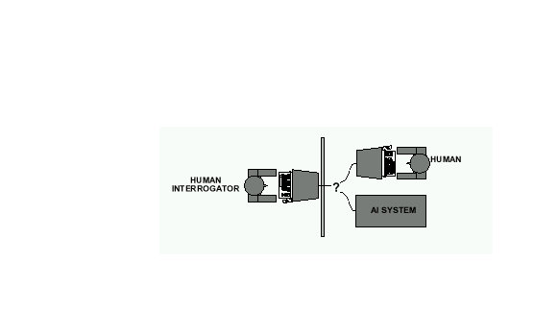
Alan Turing's 1950 article Computing Machinery and Intelligence discussed conditions for considering a machine to be intelligent
  “Can machines think?” ←→ “Can machines behave intelligently?”
  The Turing test (The Imitation Game): Operational definition of intelligence.
Computer needs to posses:Natural language processing, Knowledge representation, Automated reasoning, and Machine learning
Problem: 1) Turing test is not reproducible, constructive, and amenable to mathematic analysis. 2) What about physical interaction with interrogator and environment?
Total Turing Test: Requires physical interaction and needs perception and actuation.

Slide 12
2. Thinking humanely
Brings together computer models from AI and experimental techniques from psychology to try to construct precise and testable theories of the working of the human mind

Slide 13
3. Thinking rationally
Uses laws of thought to govern the operation of mind and give birth to logic
The logical approach has two shortcomings;
  Not easy to take informal knowledge and state it in the formal terms required by logical notation
  There is a big difference between being able to solve a problem ‘in principle’ and ‘doing so in practice’

Slide 14
4. Acting rationally
An agent is just something that acts
A rational agent acts to achieve the best outcome
This approach has two advantages;
  More general than the ‘laws of thought’
  More amenable to scientific devt than are approaches based on human behavior

Slide 15
FOUNDATIONS OF AI
Philosophy (428BC – Present)
  Can formal rules be used to draw valid conclusions?
  How does the mental mind arise from a physical brain?
  Where does knowledge come from?
  How does knowledge lead to action?
Mathematics (800 – Present)
  What are the formal rules to draw valid conclusions
  What can be computed? (incompleteness theorem)
  How do we reason with uncertain conclusion

Slide 16
FOUNDATIONS OF AI
Economics
  How should we make decisions to max payoff (utility)
  How should we do this when others may not go along (Decision theory)
  How should we do this when the payoff may be far in the future

Slide 17
FOUNDATIONS OF AI
Neural Science (1861 – Present)
  How do brains process information?
Psychology (1940 – Present)
  How do humans and animals think and act?
Computer Engineering (1940 – Present)
  How can we build an efficient computer?
Control Theory & Cybernetics (1948 – Present)
Linguistics
  How does language relate to thoughts

Slide 18
Earlier uses of AI
Playing games - Draughts
The idea is to capture the opponent's pieces.
The player should also strive to reach the other end of the board to attain the status of a queen to gain more movement power.
Is a computer more intelligent if it beats you in a game of draughts?

Slide 19
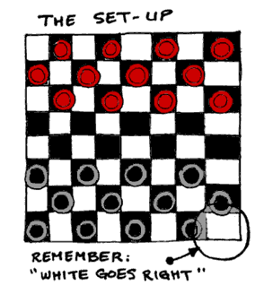

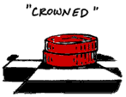
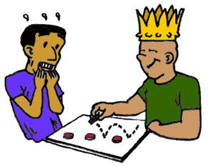
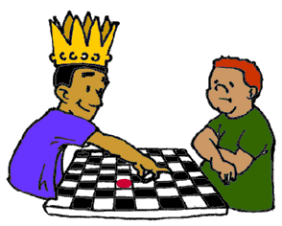
PLAYING DRAUGHTS
,
Is a computer more intelligent
if it beats you in a game of draughts?

Slide 20
Playing games- Scrabble
The idea is to write words with winning numbers.
The player should also strive to use all his seven pieces at a go to win a bonus
Again- Is a computer more intelligent if it beats you in a game of Scrabble?

Slide 21
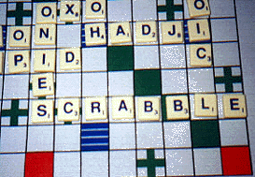
PLAYING SCRABBLE
Is a computer more intelligent
if it beats you in a game of scrabble?

Slide 22
Intelligence - Types
Linguistic/verbal
Logical/Mathematical
Musical
Spatial
Intrapersonal
Interpersonal
Naturalist
Bodily-Kinesthetic
Theoretical foundations
For recognizing different
Talents and abilities in
People

Slide 23
Intelligence - Types
What makes life interesting however is that we have different strengths in each intelligent area.
Just like we look different from one another and have different kind of personalities, we also have different kind of minds

Slide 24
AI APPLICATIONS
ALVINN
MYCIN, PROSPECTOR,..
Deep Blue
Data Mining
...

Slide 25
ALVINN
Drives 70 mph on a public highway
30 outputs for steering
30x32 pixels as inputs

Slide 26
DATA MINING
An application of machine learning techniques.
It solves problems that humans cannot solve because the data involved is too large.
A similar application is in marketing products by predicting customer behavior, fraud detection etc.

Slide 27
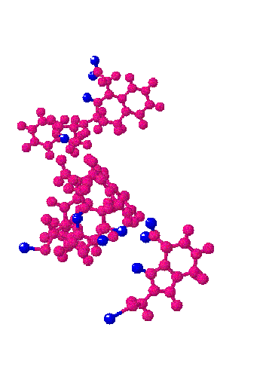
Which characteristics in the 3-dimensional structure of new molecules indicate that they may cause cancer ?
DATA MINING
Detecting cancer
risk molecules is
one example.

Slide 28
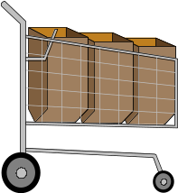









Application of Data mining
Predicting customer
behavior in
supermarkets is
another.

Slide 29
BRANCHES OF AI
Machine vision
Speech synthesis and recognition
Machine learning
Robotics
Natural language and understanding
Problem solving
Game playing

Slide 30
APPLICATIONS
Computer vision
Image recognition
Language and speech processing
Robotics

Slide 31




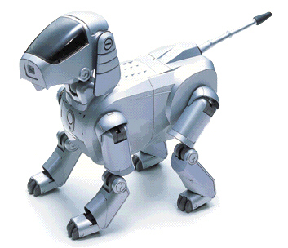
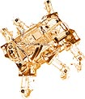
AI APPLICATION
Computer vision
Image Recognition
Language and speech processing
Robotics

Slide 32
AI as a multi-disciplinary domain
Engineering
  Robotics, vision, control expert systems, biometrics
Computer Science
  AI lang, knowledge representation, algorithms
Pure sciences
  Statistics approaches, neural nets, fuzzy logic
Linguistics
  Computational linguistics, phonetics and speech,…
Psychology
  Cognitive models, knowledge extraction from experts

Slide 33
AI as a multi-disciplinary domain (example applications)
Medicine
  Human neural models, neural science, disease diagnosis, etc
Medical Diagnosis - MYCIN
  1971, A program that could diagnose blood infections. It had 450 rules (Uses knowledge representation)
Mineral Prospecting - PROSPECTOR
  1979, A program that with geological data. It recommended exploratory drilling sites that proved to have substantial molybdenum deposits

Slide 34
HISTORY OF AI DEVT.
1943 McCulloch & Pitts: Boolean circuit model of brain
1950 Turing’s “Computing Machinery and Intelligence”
1950s Early AI programs, including Samuel’s checkers (draughts) program
Newell & Simon’s Logic Theorist, Gelernter’s Geometry Engine
1956 Dartmouth meeting: “Artificial Intelligence” adopted
1966–74 AI discovers computational complexity, Neural network research almost disappears
1969–79 Early development of knowledge-based systems
1980–88 Expert systems industry booms
1988–93 Expert systems industry busts: “AI Winter”
1985–95 Neural networks return to popularity
1988– Resurgence of probabilistic and decision-theoretic methods Rapid increase in technical depth of mainstream AI, “Nouvelle AI”: ALife, GAs, soft computing

